Slide 1
(he/him) Chair, Alan Dudley BA PG Dip MA ADHD CMT

Slide 2
Defining our terms
Boosting engagement
Creating an anthology
Committee expansion
Leadership development
Community Project Officer
Asking how your environment disables you
Making meetings work
Championing equity

Slide 3
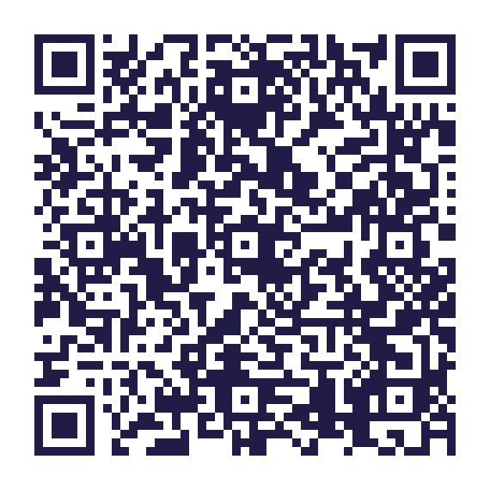
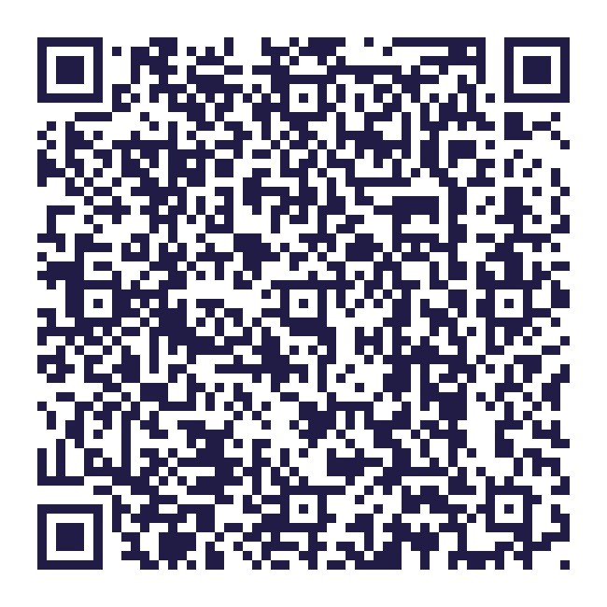
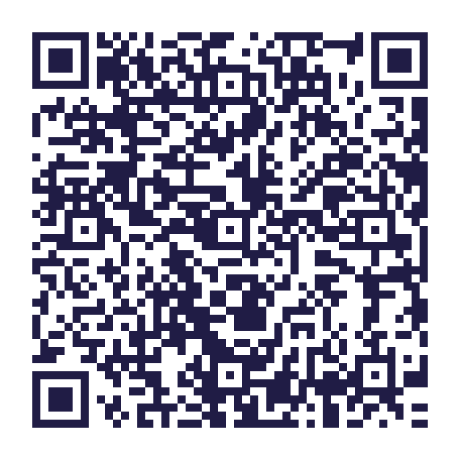
Key policies
EDI Policy Statement
Strategy 2021-2030
People Sub-strategy 2022-30

Slide 4
Connect and collaborate…
A.C.Dudley@gre.ac.uk

