Slide 1
Welcome

Slide 2
Welcome all
Firstly, thank you for coming today.
Myself and my fellow Exec Officers and Directors are delighted you have joined us.
You will have received the timetable and the presentations early this week.
The presentations will have subtitles and will be recorded.
The recordings will be available via the NADSN website sometime next week.

Slide 3
Housekeeping
No fire alarms are scheduled. If the alarm does go off, follow the ambassadors to the safe space.
The toilets are out of the door and turn right. The accessible loo is in this building, and the ladies and gents are across the quad on the ground floor.
There is a quiet space allocated in the room across from our main door here.
If you feel unwell, please let myself or one of the STAART Ambassadors or Graduates know. All of our security staff are first aiders, and an ambulance can be called if need be.

Slide 4
Admin
For those of you who are happy to appear in any conference photos published via the STAART social channels, please ensure you completed one of the media consent forms if you have not done so already.
You will have also received the list of attendees who are happy to share their contact details with you and we recommend you connect with others today, and extend your tribe.
A full risk assessment and due diligence forms have been completed by all of our external guests.

Slide 5
Plan for the day
We will hopefully have an enjoyable and thought-provoking conference and celebration.
We will be joined by our VC and Ceo, Professor Jane Harrington and our Director of EDI, Banji Adewumi.
There will be a break in the morning, lunch, a break in the afternoon and an informal networking session at the end of the day.
We have also provided resources for the latest STAART ART Prize Competition – Put on Your Positive Pants.
Once the networking has finished, we will be able to see some of our campus lit up purple.
I will now hand you over to Hamied and Alan for the first presentation.

Slide 6
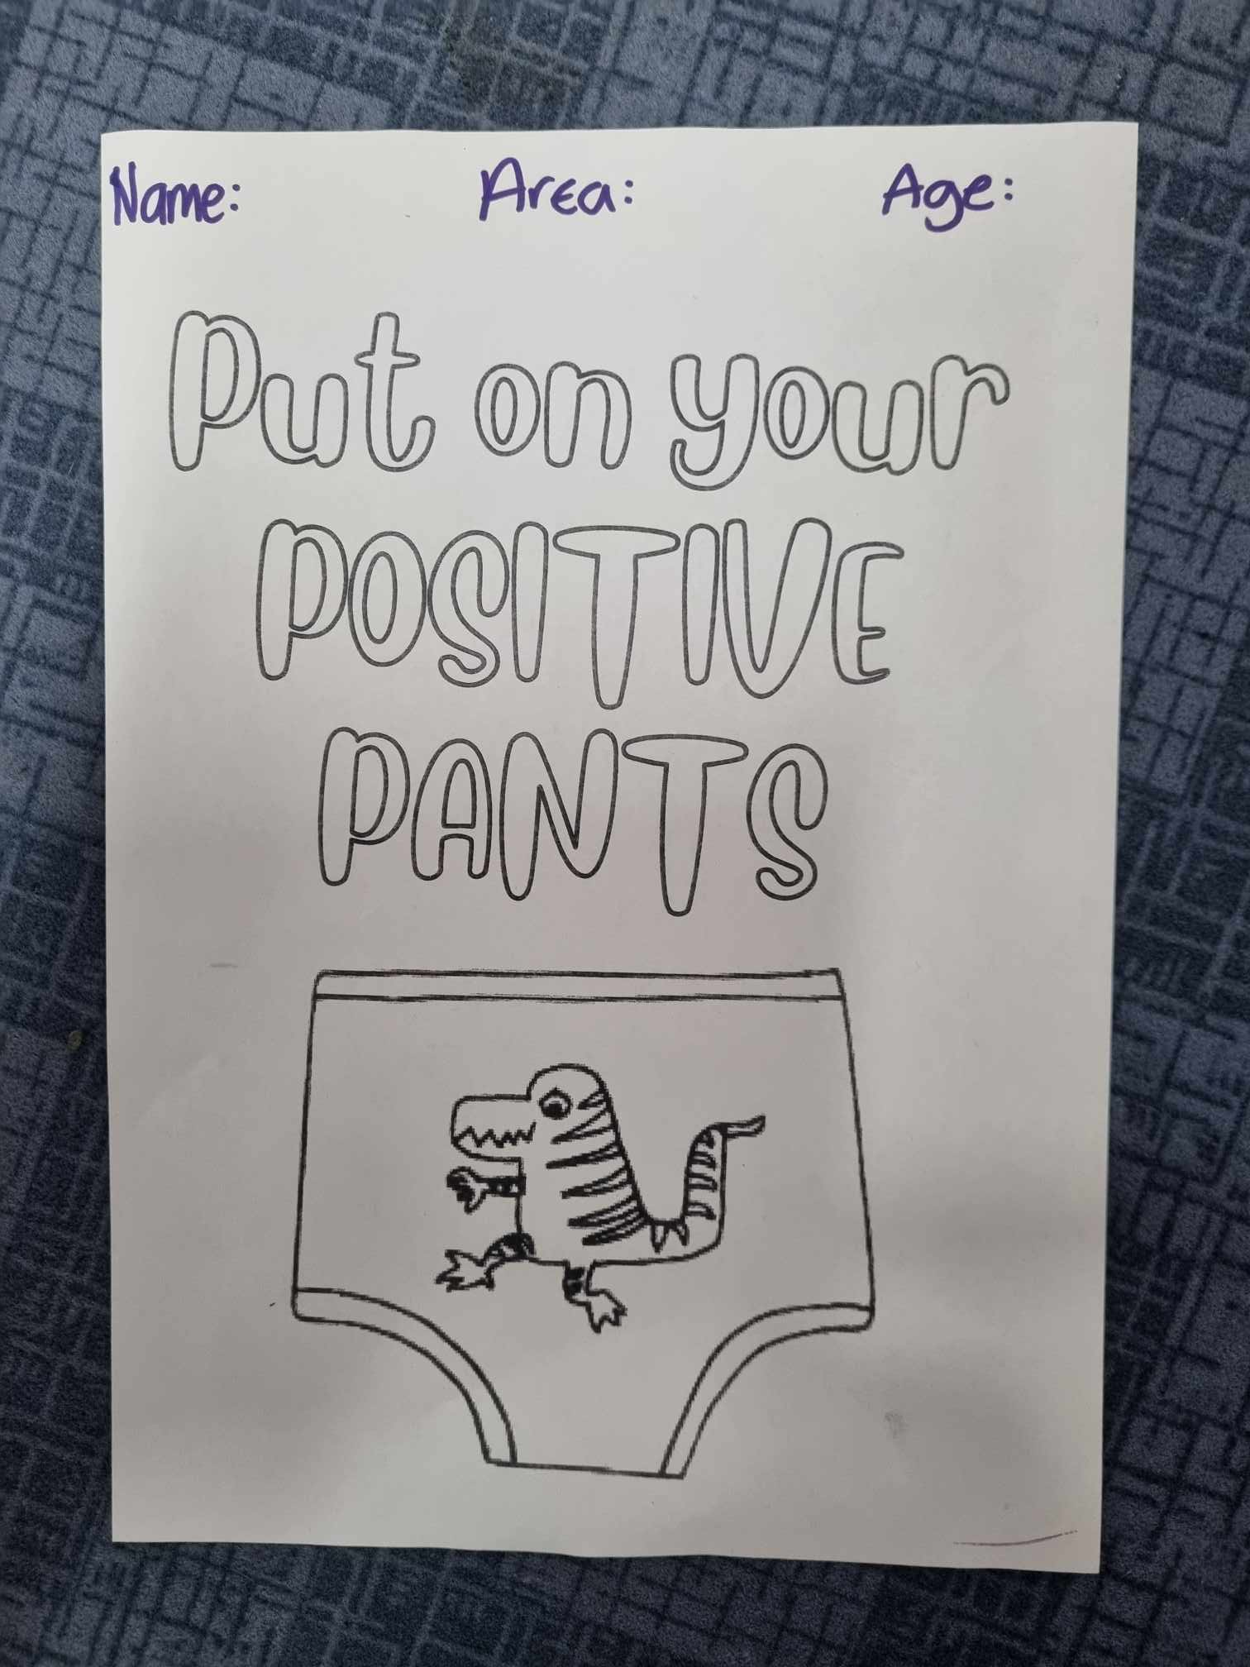
Put on Your Positive Pants
As always, our art competitions are open to anybody, of any age, and any location. The first prize is a £50 Amazon voucher and there are two runners-up prizes of £20 each. The top nine images will be displayed in our permanent STAART ART Galleries on our Greenwich and Medway campuses. Artists will need to use the template.
STAART ART https://www.facebook.com/groups/1494748690692646
December 1st to 31st January.

Slide 7
Final thoughts
We hope you have enjoyed your day and made some new connections.
Many thanks to all of our presenters for your time and energy.
NADSN – National Association of Disabled Staff Networks
STAART | Support | University of Greenwich

