Slide 1
“Driving best disability practice across the sector”
RIDE Higher
“Realising the inclusion of disabled employees in Higher Education”
Dr Melanie Best
Academic
DSN co-chair
HR Disability Advisor
NADSN Steering Committee
Chair of RIDE HIGHER
OCD ‘sufferer’

Slide 2
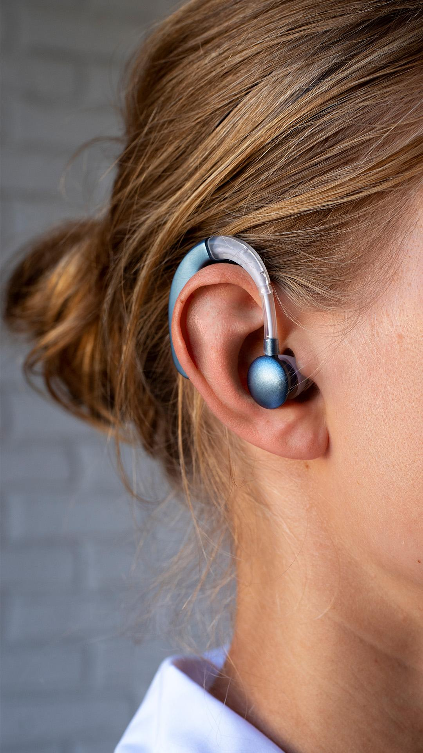
CONTEXT

Slide 3
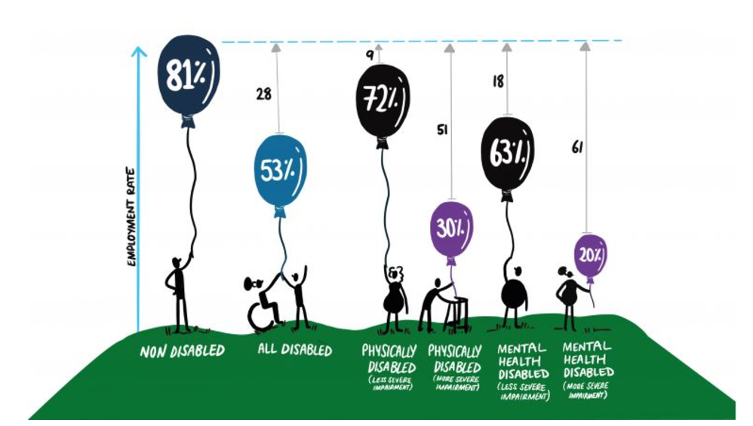
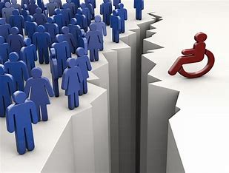
Disability - Wider Context
53% of disabled adults in work compared to 81.6% of non-disabled adults in Q2 of 2024 (DWP, 2024)
Disabled adults earned £1.56/hour less (EHRC, 2017).
Government goal of 1 million more disabled people in work by 2027 (DWP, 2023).
Notes:
Unpacking the disability employment gap 3 year project at University of Sheffield illustrated the gap by disability type

Slide 4
Where does Disability fit in HE?
6.85% of staff employed shared a disability (2020/21)¹
17.3% of students shared a disability (2020/21)²
The ‘unexpected workers’ of HE³
Glass partitions & ceilings⁴
The Disabled Student Commitment
Charters for other protected characteristics
Institutional disability action plans/frameworks
“Some institutions appeared to accept low reporting rates for disability as a sector-wide phenomenon, seemingly making little or no effort to foster
a culture where staff feel comfortable to disclose their personal circumstances as a routine part of their employment” (REF, EDAP, p. 19).
¹ Advance HE (2023), ² Hubble & Bolton (202)1, ³ Waterfield et al. (2018), ⁴ Roulstone & Williams (2014)
Notes:
Declaration rates higher in professional services staff (Advance HE, 2021).
29.7% of disabled academics were earning £50,000+, compared to 37.5% of non-disabled academics, with a 3.5% pay gap for those in the professional services (Advance HE, 2023).
Rates of disclosure are particularly low for professors (4%), senior managers (<5%)those on research-only contracts (5.5%)
The limited disabled workforce in HE, including in seniority, limits the role models, perceived accessibility of Universities and aspirations of disabled students.
Disabled students have worse outcomes in HE than non-disabled students, are more likely to drop-out of courses, tend to have lower degree results and have worse employment outcomes.
On average 1 disability student advisor is supporting up to 583 students (Borkin, nd). However very few Universities employ any disability staff advisors.

Slide 5
“I want to progress and move on to a managerial role, but I have had too many sick days…I am just stuck now.”
HE Jobs: “They just aren’t accessible. Even the essential criteria can unintentionally sift out disabled applicants.”
Securing Reasonable Adjustments: “I couldn't balance getting people to see how important that was to me without pushing so much that they thought I was incapable of doing my job.”
Notes:
My own experience

Slide 6
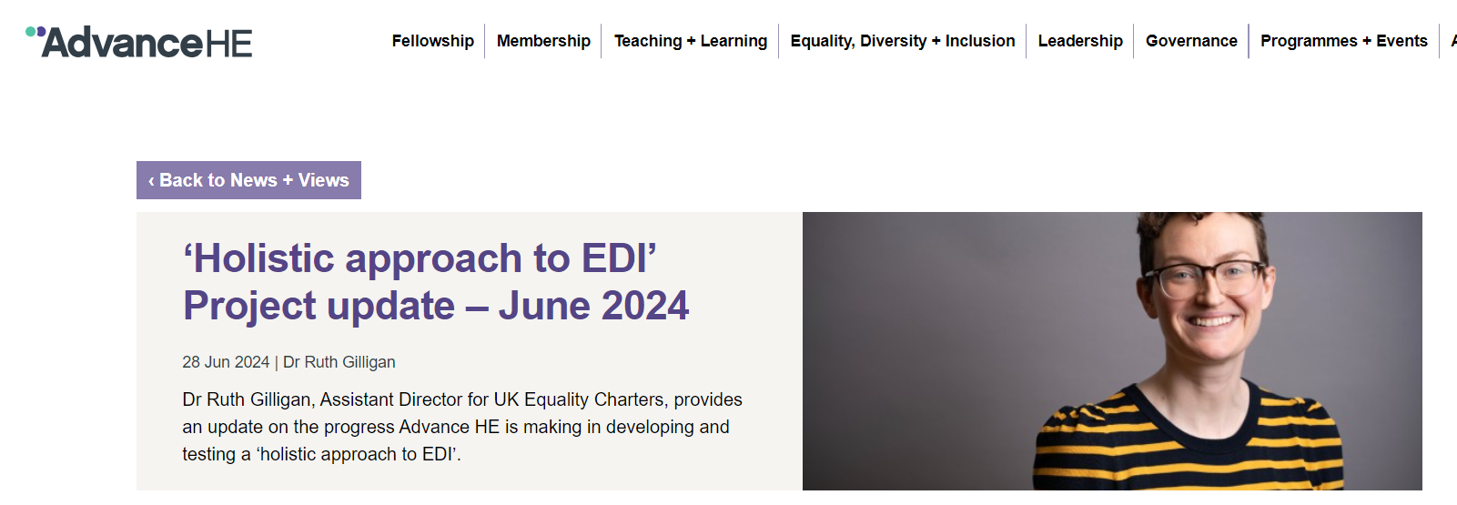

Slide 7
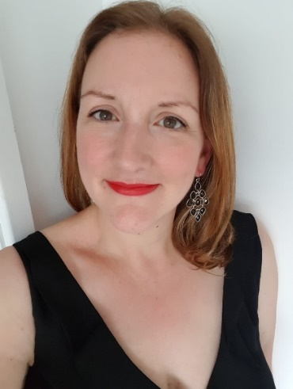
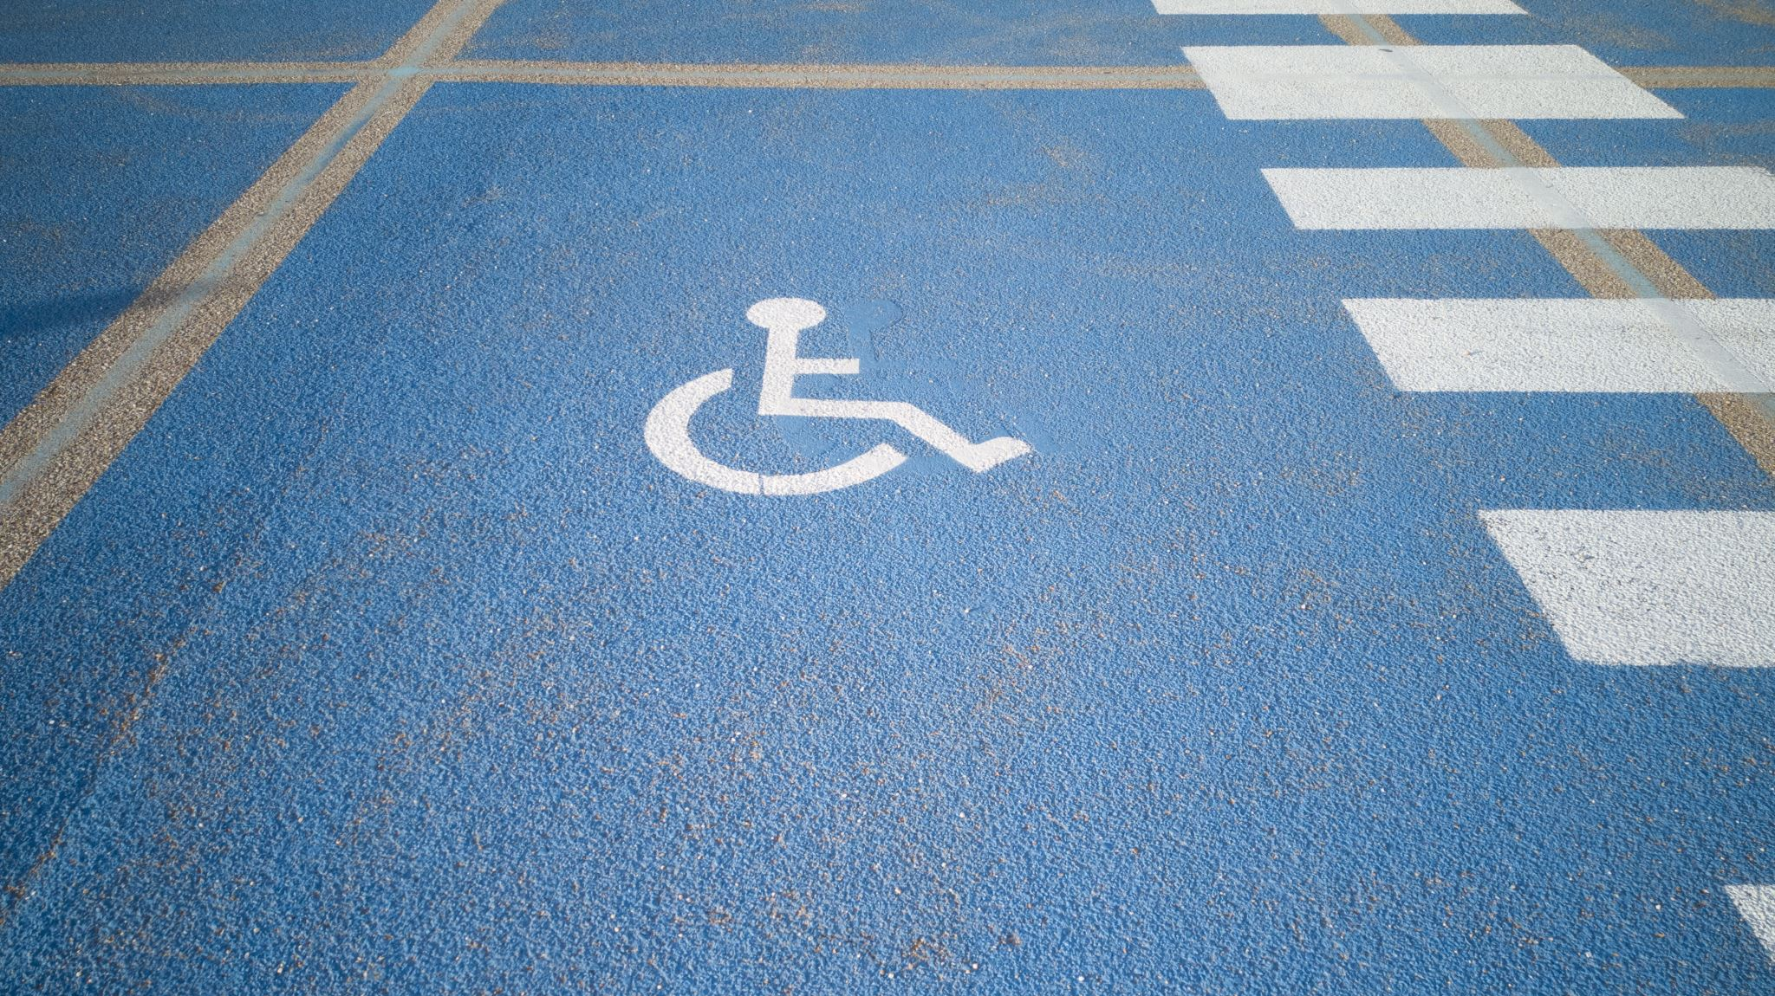
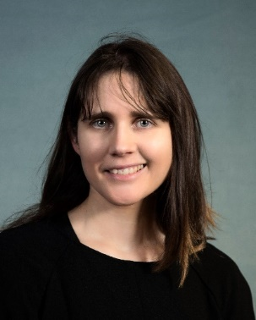
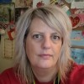
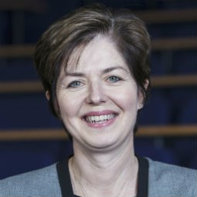
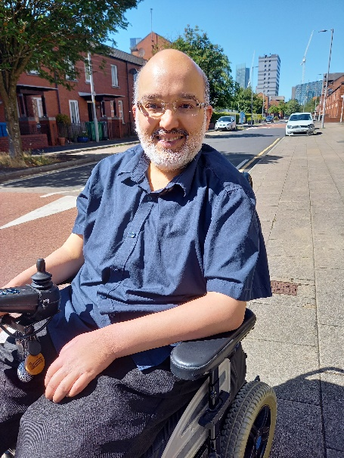
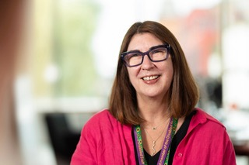
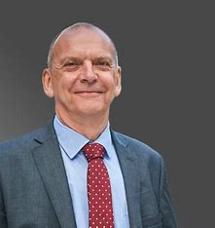
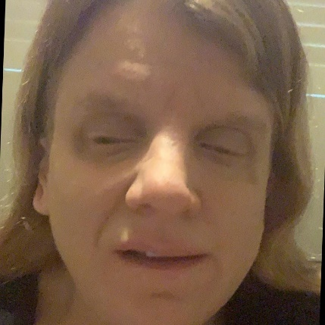
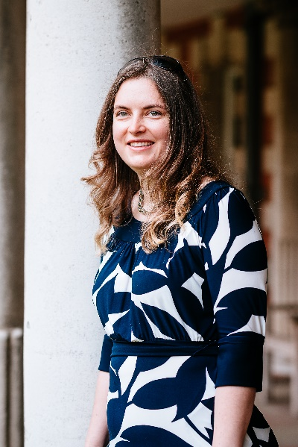
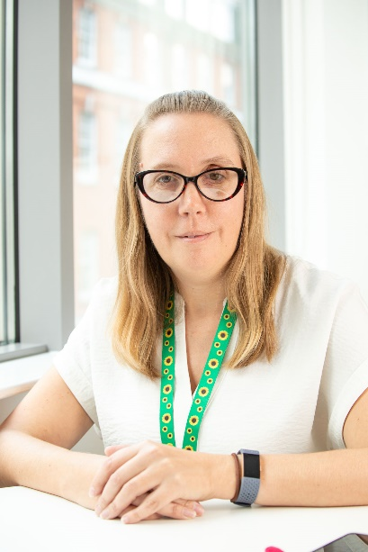
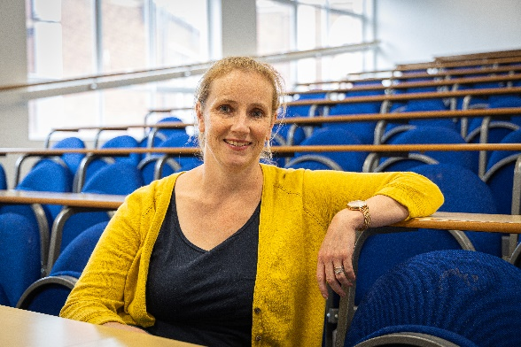
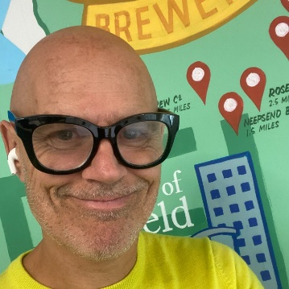
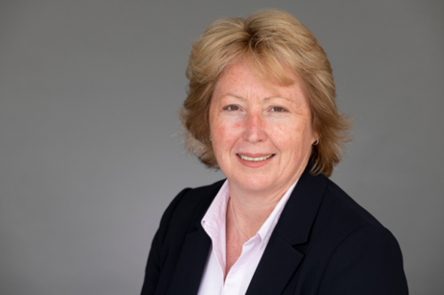
RIDE Higher
By and For Disabled Employees in HE
Notes:
VCs, Deans, Academics, PS staff, EDI leads, DSN chairs, Gov advisor
Volunteers

Slide 8
ABOUT RIDE HIGHER

Slide 9
Preparing to RIDE HIGHER
1
2
3
4
Join-up
Self-assessment
Case study selection
Action & impact
Note: Universities can start at Step 3
Disabled employees are seen, valued and can thrive.
Free & accessible to all
Notes:
Case studies – audited – not an endorsement of RIDE Higher/NADSN
Buddying up

Slide 10
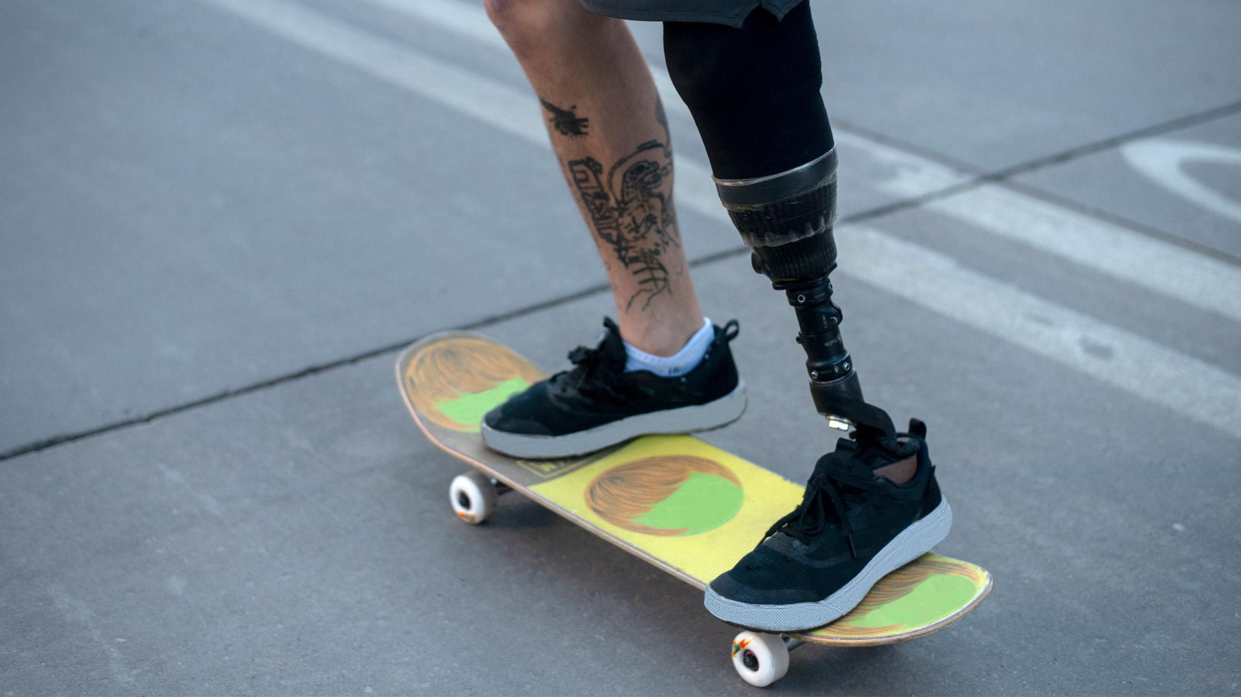
Non-punitive
Achievable
Meaningful
No auditing or accreditation
Support from HEI Network
Open to all
One issue at a time
HEI decides the pace
Not resource-heavy
No cost
Blueprints to follow
Listen, learn & lead
Part-owned by DSN
Share practices for disabled students too

Slide 11
Why should HEIs sign up?

Slide 13
01
Cost-saving & income generation
Lower staff turnover, sick leave & grievances
More diverse staff body to reflect/connect with students
02
The DSC, UMHC
Disability Confident
Advance HE future holistic charter
Overlaps with & evidence base for other charters
03
Minimise risk of legal cases
Support REF outcomes – PCE indicators
NDSS & a call to action
Meeting equality duties & EIA targets – linked to REF and research
04
Role models for disabled students & staff
Purple talent not wasted/overlooked
Reputation enhanced
A culture of disability inclusion
Notes:
Natasha Abrahart parents – attending mental health awareness talk UoW

Slide 14
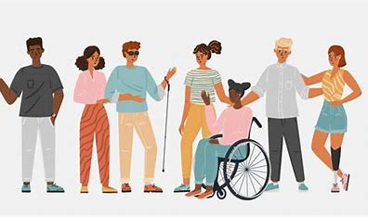
“Systems don’t change easily. Systems try to maintain themselves and seek equilibrium. To change a system, you need to shake it up, disrupt the equilibrium.”
Notes:
Universities should be the generators of knowledge, leading the way….but in this space they are not, and that needs to change.
The world is changing……I did a webinar with British Judo a few weeks ago as part of DHM – the Paralympic Coach spoke of the integrated programme, the value
and credibility of the VI athletes – of being key role models for the programme – not celebrated as supercrips based on their personality, their character, their
athletic endeavours….they set the tone. The respect and value for their VI athletes reflects an organisational culture that is empowering for these athletes, and sends a clear message for everyone else in the programme about inclusion, about disability. It can be done and it needs to be the norm.
We see the likes of GCHQ and NASA actively recruiting neurodiverse people. The video by Apple speaks of how technology bridges gaps and offers new possibilities ….it talks about ‘shaking the world’ and in this day and age advancements in technology mean more is possible, particularly for disabled people. It feels that there is a need for a shake-up in HE.
I wanted to share this video as it speaks to me about possibilities and hope

Slide 15
Timeline
Website building
Logo competition
NDSS Launch
Dec 2024
Nov 2024
#ridefurther
2025
Review of NDSS
Website launch up
Pilot
Melanie.best@wlv.ac.uk
Notes:
Wlv DHM

Slide 16
Notes:
Or, if you prefer, here they all are on one page. They will become more active soon!
You can also sign up to the JISCMail ListServ: https://www.jiscmail.ac.uk/cgi-bin/wa-jisc.exe?SUBED1=NADSN-ALL

Slide 17
Conclusions

Slide 18
ANY
QUESTIONS?

Slide 19
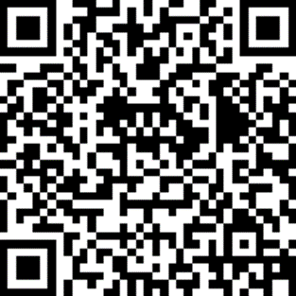
The NDSS – hearing 1000 voices
https://app.onlinesurveys.jisc.ac.uk/s/cardiff/disability-inclusion-in-higher-education [app.onlinesurveys.jisc.ac.uk]
Melanie.best@wlv.ac.uk
Notes:
PLEASE CONSIDER PARTICIPATING IN THE NDSS!
PLEASE SHARE WITH YOUR NETWORKS!
If you would like to join our working group or mailing list, please email me

