Slide 1
Welcome to Greenwich
Friday 6th December 2024

Slide 3
Is there Equity in EDI in HE and the Public Sector?
Notes:
Picture of Greenwich campus buildings in the background

Slide 4
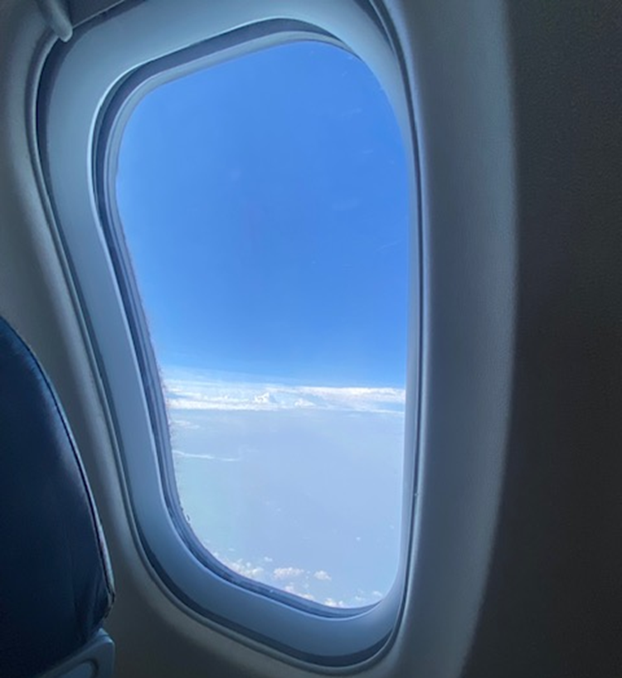
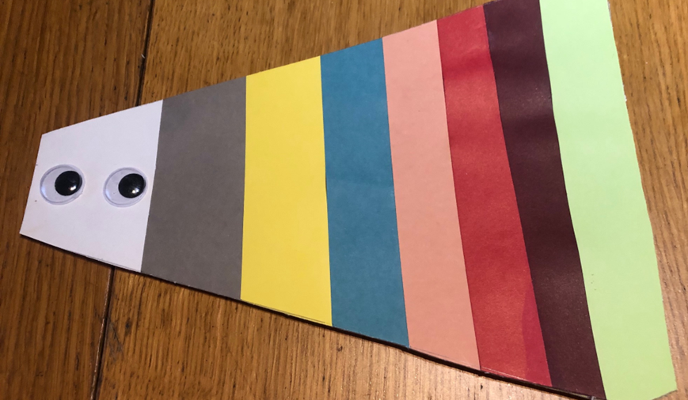
Seeing the world differently
*An invitation to Social Construction - K. J. Gergen, 2015
© OyebanjiAdewumi
Notes:
Picture of window on one side of a plane… so I ask the question, is my truth of the world, your truth?

Slide 5
Embracing Difference
© OyebanjiAdewumi

Slide 6
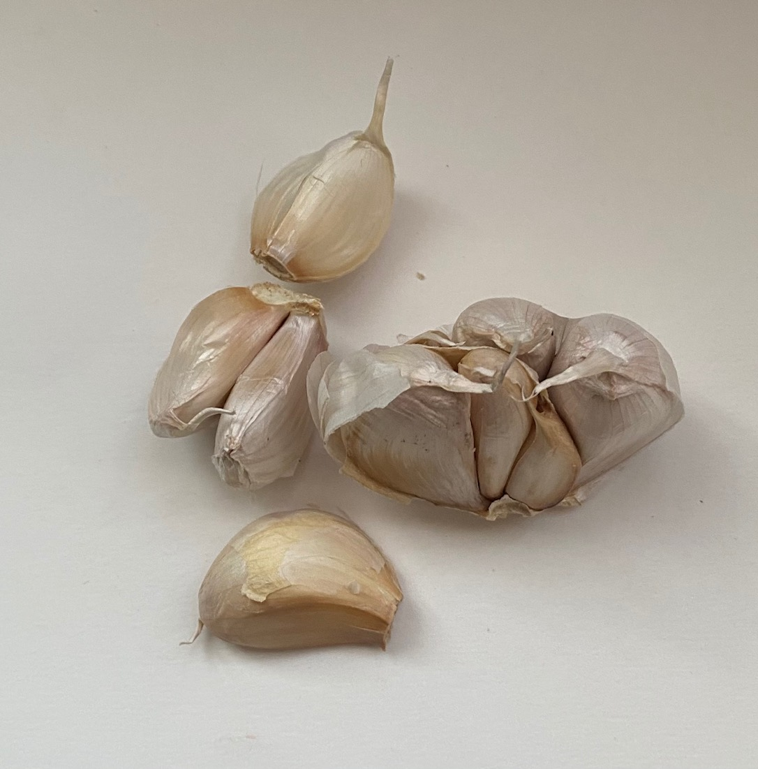
© OyebanjiAdewumi
Notes:
Picture of Garlic Bulbs and Ginger (Rhizome)

Slide 7
#Strategy2030
Inclusive | Collaborative | Impactful
Notes:
Best modern University by 2030
Sector leading for EDI

Slide 8
Thank you. Oyebanji (Banji) Adewumi MBE

